Slide 1

Customer Shopping Behavior Analysis
Uncovering insights from 3,900 purchases to guide strategic business decisions.

Slide 2

Project Overview & Dataset
Project Goal
Key Features
Analyze spending patterns, customer segments, product preferences, and subscription behavior.
Customer demographics (Age, Gender, Location, Subscription)
Purchase details (Item, Category, Amount, Season, Size, Color)
Shopping behavior (Discount, Promo, Previous Purchases, Frequency, Review, Shipping)
Dataset: 3,900 rows, 18 columns.

Slide 3
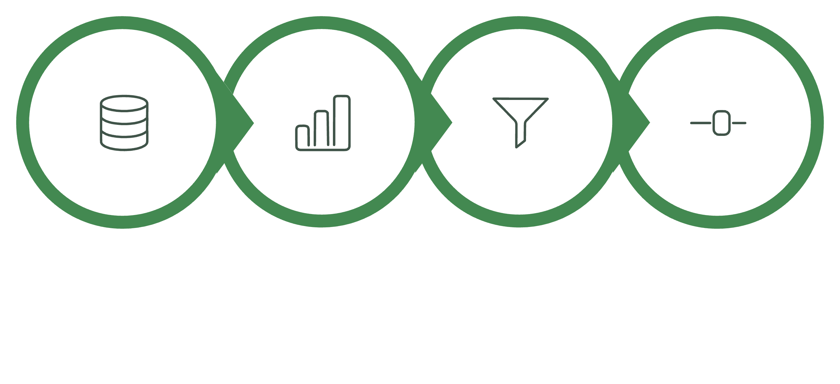

Exploratory Data Analysis (Python)
Missing Data Handling
Column Standardization
Data Loading
Initial Exploration
Data was cleaned and prepared using Python for robust analysis.

Slide 4

Feature Engineering & Database Integration
Feature Engineering
Created `age_group` by binning customer ages.
Created `purchase_frequency_days`.
Data Consistency
Removed redundant `promo_code_used` column.
Database Integration
Cleaned data loaded into PostgreSQL for SQL analysis.

Slide 5

SQL Analysis: Key Business Insights
Revenue by Gender
Male customers generated $157,890, Female $75,191.
High-Spending Discount Users
839 customers used discounts but spent above average.
Top 5 Products by Rating
Gloves (3.86), Sandals (3.84), Boots (3.82), Hat (3.80), Skirt (3.78).

Slide 6

Shipping & Subscription Insights
Shipping Type Comparison
Subscribers vs. Non-Subscribers
Average purchase: Express $60.48, Standard $58.46.
Subscribers: 1,053 customers, $62,645 total revenue.
Non-subscribers: 2,847 customers, $170,436 total revenue.

Slide 7


Product & Customer Segmentation
Discount-Dependent Products
Customer Segmentation
Hat (50%), Sneakers (49.66%), Coat (49.07%), Sweater (48.17%), Pants (47.37%).
Loyal (3,116), Returning (701), New (83).

Slide 8

Top Products & Age Group Revenue
Top 3 Products per Category
Revenue by Age Group
Young Adult: $62,143
Middle-aged: $59,197
Adult: $55,978
Senior: $55,763
Accessories: Jewelry, Sunglasses, Belt
Clothing: Blouse, Pants, Shirt
Footwear: Sandals, Shoes, Sneakers
Outerwear: Jacket, Coat

Slide 9
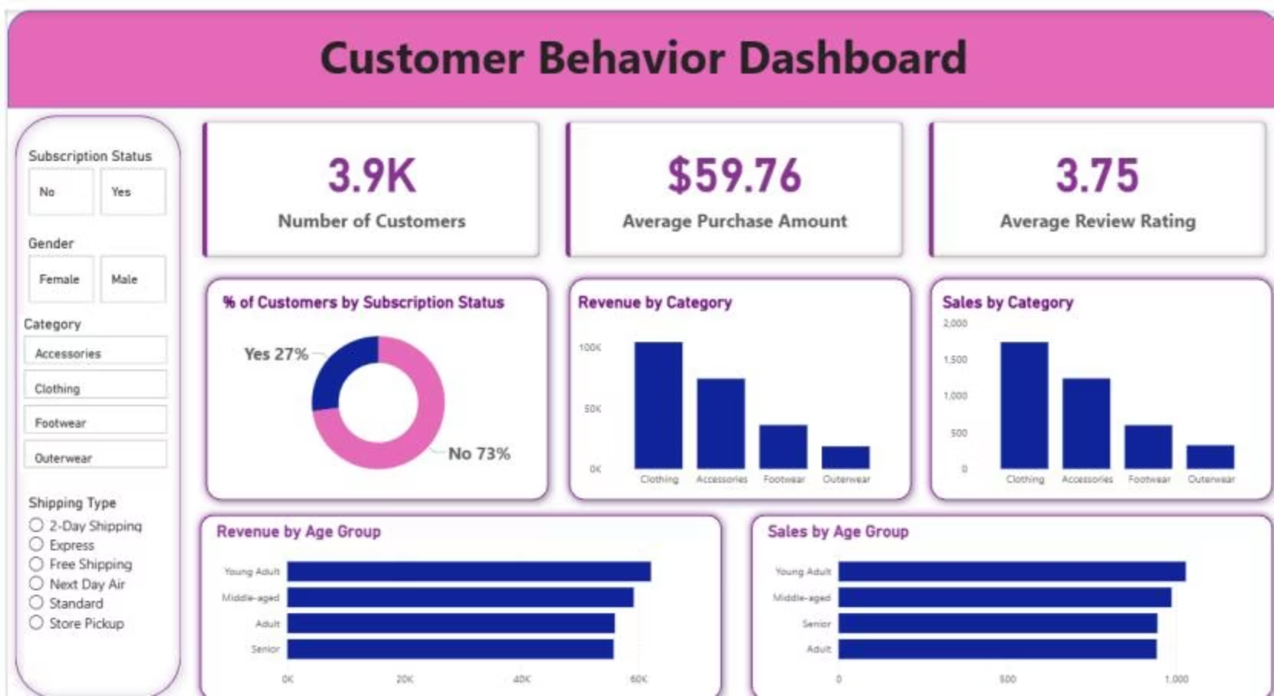
Dashboard in Power BI
Interactive dashboard visualizes key metrics: 3.9K Customers, $59.76 Avg. Purchase, 3.75 Avg. Review.

Slide 10
Business Recommendations
Boost Subscriptions
1
Promote exclusive benefits for subscribers.
Customer Loyalty Programs
2
Reward repeat buyers to foster loyalty.
Review Discount Policy
3
Balance sales boosts with margin control.
Product Positioning
4
Highlight top-rated and best-selling products.
Targeted Marketing
5
Focus on high-revenue age groups and express-shipping users.

